Slide 1



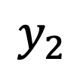
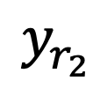
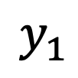
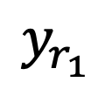



$$y_{r_{1}}$$
-
$$G_{c_{11}}$$
$$G_{11}$$
$$y_{1}$$
+
+
+
$$G_{21}$$
$$G_{12}$$
$$y_{r_{2}}$$
$$G_{c_{22}}$$
$$G_{22}$$
+
$$y_{2}$$
+
+
-

Slide 2


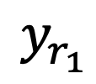

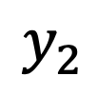

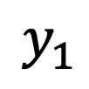


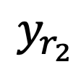


$$y_{r_{1}}$$
-
$$G_{c_{11}}$$
$$G_{11}$$
$$y_{1}$$
+
+
+
+
+
$$D_{21}$$
$$G_{21}$$
$$D_{12}$$
$$G_{12}$$
$$y_{r_{2}}$$
$$G_{c_{22}}$$
+
$$G_{22}$$
+
$$y_{2}$$
+
+
+
-

